Slide 1
IT694 Computer Networks Week7 – Lec2
TCP Congestion Control

Slide 2

Approaches towards congestion control
End-end congestion control:
no explicit feedback from network
congestion inferred from observed loss, delay
ACKs
data
data
ACKs
approach taken by TCP

Slide 3
Questions for Congestion Control
How does a TCP sender limit the rate at which it sends traffic into its connection?
How does a TCP sender perceive that there is congestion on the path between itself and the destination?
What algorithm should the sender use to change its send rate as a function of perceived end-to-end congestion?

Slide 4
Questions for Congestion Control
How does a TCP sender limit the rate at which it sends traffic into its connection?
How does a TCP sender perceive that there is congestion on the path between itself and the destination?
What algorithm should the sender use to change its send rate as a function of perceived end-to-end congestion?
Acknowledgment Arrived → Segment delivered→ sender’s rate can be increased when an
Segment Lost → Congestion → Decrease TCP sender’s rate
Bandwidth probing:
1. Increase →transmission rate → Checking when congestion begins
2. Back off → Decrease Transmission rate
Repeat steps 1 and 2
Collectively
SLOW START
CONGESTION AVOIDANCE
FAST RECOVERY

Slide 5
Q1: TCP congestion control: details
sender sequence number space
TCP sending behavior:
roughly: send cwnd bytes, wait RTT for ACKS, then send more bytes
cwnd
last byte
ACKed
cwnd
sent, but not-yet ACKed
(“in-flight”)
available but not used
TCP rate
~
bytes/sec
~
RTT
last byte sent
TCP sender limits transmission:
cwnd is dynamically adjusted in response to observed network congestion (implementing TCP congestion control)
<
cwnd
LastByteSent- LastByteAcked

Slide 6

TCP slow start
Host A
Host B
when connection begins, increase rate exponentially until first loss event:
initially cwnd = 1 MSS
double cwnd every RTT
done by incrementing cwnd for every ACK received
one segment
RTT
two segments
summary: initial rate is slow, but ramps up exponentially fast
four segments
if MSS = 500 bytes and RTT = 200 msec, the resulting initial sending rate is only about 20 kbps
time

Slide 7
TCP congestion control: AIMD
approach: senders can increase sending rate until packet loss (congestion) occurs, then decrease sending rate on loss event
Additive Increase
Multiplicative Decrease
increase sending rate by 1 maximum segment size every RTT until loss detected
cut sending rate in half at each loss event
AIMD sawtooth
behavior: probing
for bandwidth
TCP sender Sending rate
time

Slide 8
TCP AIMD: more
Multiplicative decrease detail: sending rate is
Cut in half on loss detected by triple duplicate ACK (TCP Reno)
Cut to 1 MSS (maximum segment size) when loss detected by timeout (TCP Tahoe)
Why AIMD?
AIMD – a distributed, asynchronous algorithm – has been shown to:
optimize congested flow rates network wide!
have desirable stability properties

Slide 9
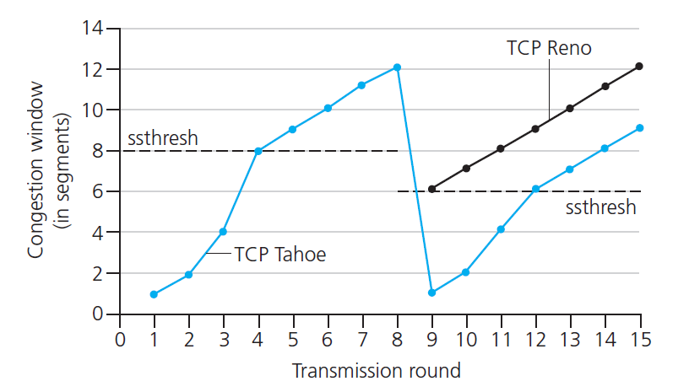

TCP: from slow start to congestion avoidance
Q: when should the exponential increase switch to linear?
A: when cwnd gets to 1/2 of its value before timeout.
X
Implementation:
variable ssthresh
on loss event, ssthresh is set to 1/2 of cwnd just before loss event
Congestion window VIDEO

Slide 10

TCP fast retransmit
Host A
Host B
TCP fast retransmit
if sender receives 3 additional ACKs for same data (“triple duplicate ACKs”), resend unACKed segment with smallest seq #
likely that unACKed segment lost, so don’t wait for timeout
Seq=92, 8 bytes of data
Seq=100, 20 bytes of data
X
ACK=100
timeout
ACK=100
ACK=100
Receipt of three duplicate ACKs indicates 3 segments received after a missing segment – lost segment is likely. So retransmit!
ACK=100
Seq=100, 20 bytes of data
Notes:
Let’s wrap up our study of TCP reliability by discussing an optimization to the original TCP known as TCP fast retransmit,
Take a look at this example on the right where 5 segments are transmitted and the second segment is lost. In this case the TCP receiver sends an ACK 100 acknowledging the first received segment.
When the third segment arrives at the receiver, the TCP receiver sends another ACK 100 since the second segment has not arrived. And similarly for the 4th and 5th segments to arrive.
Now what does the sender see? The sender receives the first ACK 100 it has been hoping for, but then three additional duplicate ACK100s arrive. The sender knows that somethings’ wrong – it knows the first segment arrived at the receiver but three later arriving segments at the receiver – the ones that generated the three duplicate ACKs – we received correctly but were not in order. That is, that there was a missing segment at the receiver when each of the three duplicate ACK were generated.
With fast retransmit, the arrival of three duplicate ACK causes the sender to retransmit its oldest unACKed segment, without waiting for a timeout event. This allows TCP to recover more quickly from what is very likely a loss event
specifically that the second segment has been lost, since three higher -numbered segments were received

Slide 11
TCP: from slow start to congestion avoidance
Q: when should the exponential increase switch to linear?
A: when cwnd gets to 1/2 of its value before timeout.
X
Implementation:
variable ssthresh
on loss event, ssthresh is set to 1/2 of cwnd just before loss event
Congestion window VIDEO

Slide 12
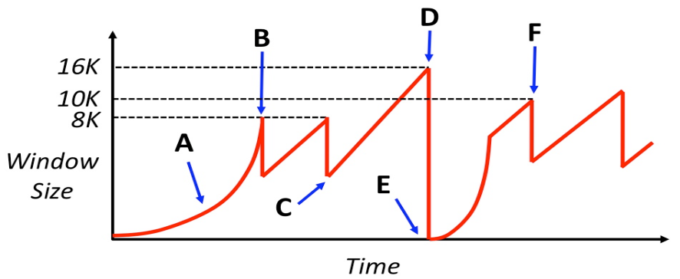
Name the event at B which occurs that causes the sender to decrease its window.
Does the event at B necessitate that the network discarded a packet (Yes or No)? Why or
Name the event at D which occurs that causes the sender to decrease its window.
For a lightly-loaded network, is the event at D MORE likely or LESS likely to occur when the sender has multiple TCP segments outstanding? (Write “MORE” or “LESS”)
Triple duplicate ACK
No. It could be due to reordering due to queuing or asymmetric paths.
Timeout
LESS

Slide 13
Assume that the network has an MSS of 1000 bytes and the round-trip-time between sender and receiver of 100 milliseconds. Assume at time 0 the sender attempts to open the connection. Also assume that the sender can “write” a full window’s worth of data instantaneously, so the only latency you need to worry about is the actual propagation delay of the network.
How much time has progressed by point B?
ANS: 1 RTT (TCP handshake) + 3-4 RTT in slow-start (1, 2, 4, (8) MSS) = 4 or 5 RTT = 400 or 500 ms
(b) How much time has progressed between points C and D?
ANS: from graph, this means going from 4MSS (4000 bytes) to 16MSS(16K bytes)
Each 1MSS-2MSS-4MSS = ~3 RTTs , so 4-8-12-16(total 4 transactions 4 * 3 RTTs)
(c) How much time has progressed between points E and F?
First: slow start to 8K window size (1->2, 2->4, 4->8 MSS), then AI from 8 to 10
MSS window size (8->9->(10) MSS). Again, similar question about “where” F
exists as question (a), so we will accept either 5 or 6 RTT = 500 or 600 ms.

Slide 14
TCP Congestion
What and why congestion?
Where congestion?
How does Transport layer learn about congestion?
What does Transport layer do after learning about congestion?
What is the algorithm for congestion control?
What are the different stages in the CC algo?
Significance of each stage
What and why Fast recovery?

